Slide 1
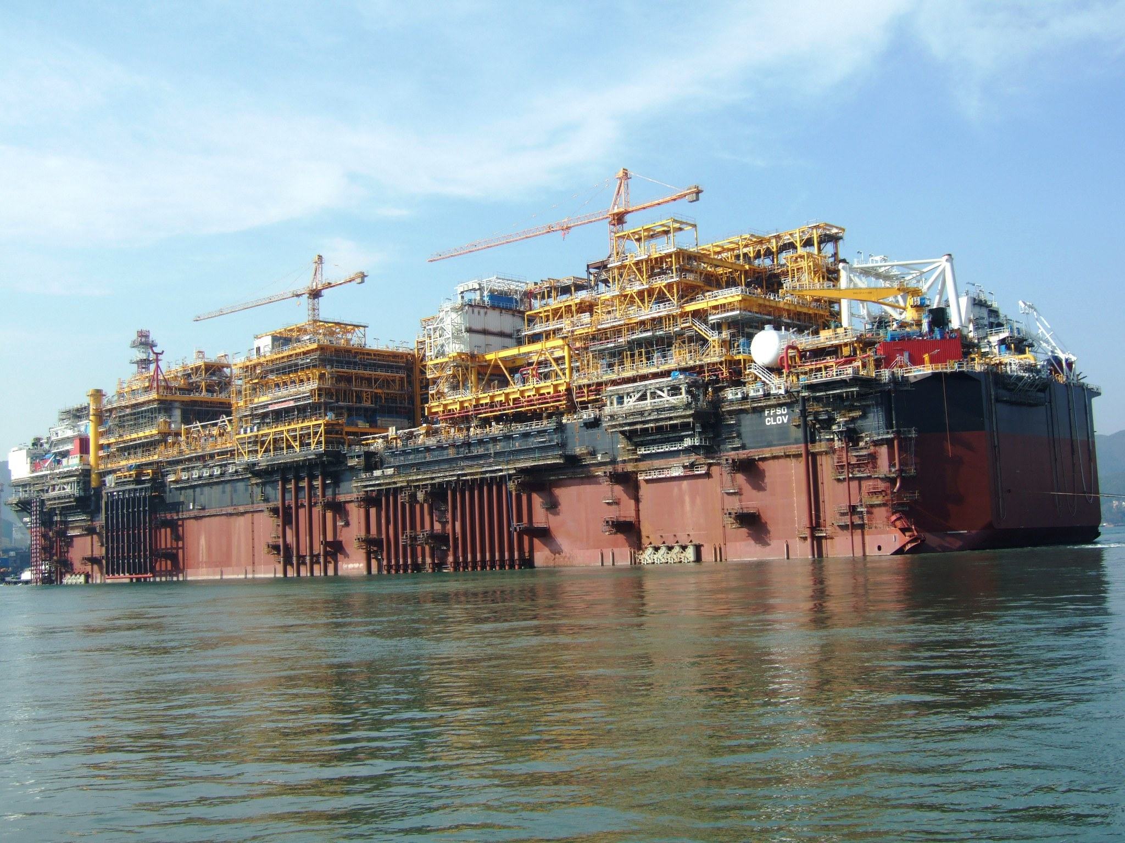
Introduction

Slide 2








A large and balanced portfolio of activities
Marine
Classification and certification of ships and offshore
floating units
Industry
Risk management, quality assurance, quality control and asset integrity management of facilities and equipment
In-service Inspection
& Verification
Periodic inspection of equipment & facilities in operation
Conformity assessment of buildings and infrastructures
Construction
Certification
Certification of QHSE management systems and second party auditing services
Commodities
Commodities inspection and testing: oil & petrochemicals, metals & minerals, agriculture
Consumer Products
Testing, inspection and certification of consumer goods
Government services & International Trade
Trade facilitation services

Slide 3
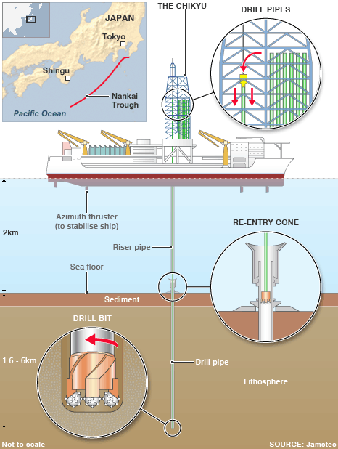
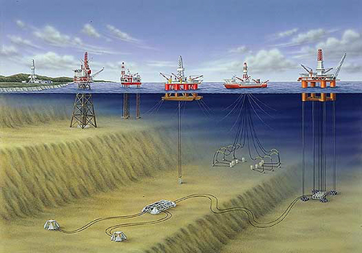
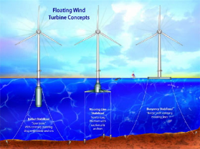
The Key Assets
Offshore is Organized Around 5 Core Families of Assets (1/2)
1- Drilling
2- Installation
3- Production
4- Storage
5- Offloading
1- Drilling Units
4- Fixed Platforms
2- Floating Units
3- Subsea Assets
5- Windmills

Slide 4




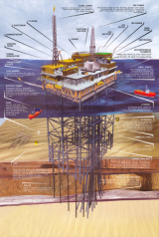

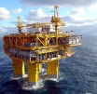



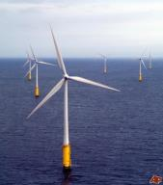

The Key Assets
Offshore is Organized Around 5 Core Families of Assets (2/2)
1- DRILLING
UNITS
Drilling Ships
Semi-Sub
Drilling Barge
Jack-Ups
4- FIXED PLATFORMS
(with Production Facilities/
”Top sides” on the top)
2- FLOATING
UNITS (with
Production
Facilities/
”Top sides”
on the top)
SPAR
FPSO
Floating Production Storage&Offloading
TLP
Tension Leg Platform
Semi-Sub
3- SUBSEA
ASSETS
5- WIND MILLS
Subsea production systems
Umbilicals
Risers
Flowlines
Rename BV Marine Division as BV Marine & Offshore Division (M&O) to integrate the offshore business.

Slide 5
BV portfolio of services (CAPEX + OPEX)
Services | Description | Type
Classification | Range of services performed on an offshore floating unit, including design review, construction surveys, attendance at sea, equipment inspections, until its delivery and during its in-service life based on BV rules | Third party
Certification | Design review, onsite audits, witness of tests and inspections to certify that an equipment, a system or an installation complies with client specifications, agreed standards or regulatory/ statutory requirements | Third party
IVB | Independent review of design and operations to certify that the Safety Case done for an installation concluded on suitable safety measures (Initial Suitability check) and that the installation design and operations complies with the performance standards | Third party
Inspection (Field Services) | Shop, site and equipment inspections performed during construction phase as an independent body (third party), within statutory certifications or as a second party on behalf of the customer | Third/ Second party
Naval & structural Consultancy | Independent technical studies in the naval and structural domains (eg: stability, mooring, hydrodynamic & structure) | Second party
HSE & Risk Engineering Services | Independent technical studies in HSE & Risk Management areas. (eg: Safety Case or studies, HAZOP, HAZID, Quantified Risk Assessments, Environmental impact assessments) | Second party
AIM Services | Review of the management processes and techniques intended to maintain the integrity of the assets in the objective to optimise costs without compromising the safety, availability, reliability or the environment (eg: Risk Based Inspection (RBI), Reliability Centred Maintenance (RCM), Reliability Availability Maintenance (RAM)). | Second party

Slide 6
Bureau Veritas O&G Competence Centers
TC NEZ
(Aberdeen / Manchester)
STC RUS
(Moscow)
Netherland
TC SEZ
(Paris / Lyon / Milan)
TC NAM
(Houston)
TC China
Korea Japan
TC MER
(Abu Dhabi)
STC AFR
(Lagos)
TC INDIA
(Mumbai)
TC SEA
(Kuala Lumpur)
TC BR
(Rio de Janeiro)
TC AUS
(Perth / Newcastle)

Slide 7
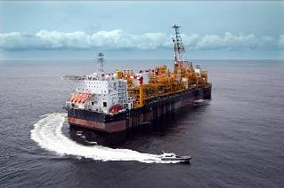
BV Offshore References

Slide 8
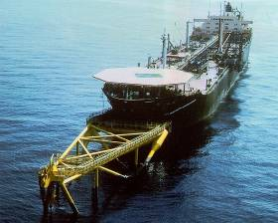
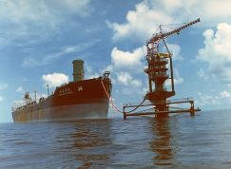
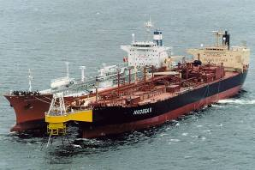
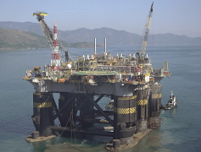
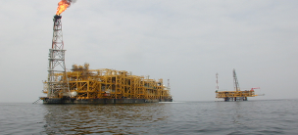
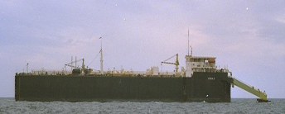
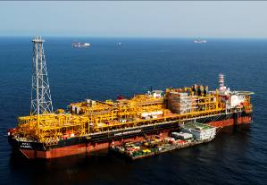
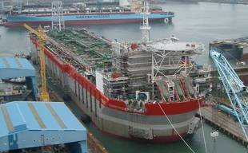
THE FIRST, THE BIGGEST AND THE DEEPEST PROJECTS
First classed FPSO,
CASTELLON DELTA
For SHELL & SBM
Spain 1979
LPG-FGSO: NKS2 (N’KOSSA) - 1996
Disconnectable
NAN HAI XI WANG - 1986
SS FPU: PETROBRAS XIX 1997 For PETROBRAS -
First purpose built & classed FSO
IFRIKA II
For SEREPT –Ashtart Tunisia 1979
Concrete hull FPU: NKP (N’KOSSA) - 1996
GIRASSOL FPSO for TOTAL
PLUTONIO FPSO for BP

Slide 9
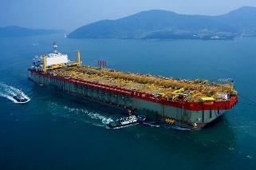
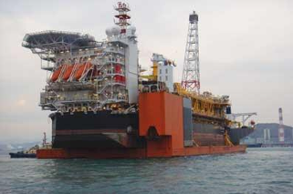
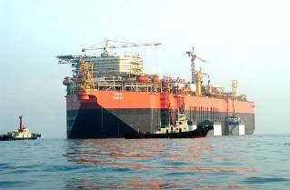
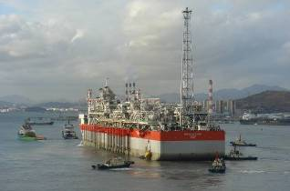
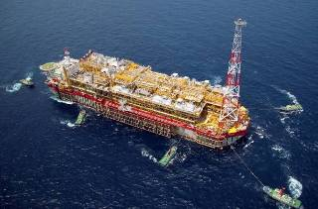
Selected Deepwater F(P)SO (New Building)
AKPO FPSO (Nigeria)
DALIA FPSO (Angola)
Alima FPU (Congo)
UNITY FSO (Nigeria)
PLUTONIO FPSO (Angola)
USAN FPSO (Nigeria)

Slide 10
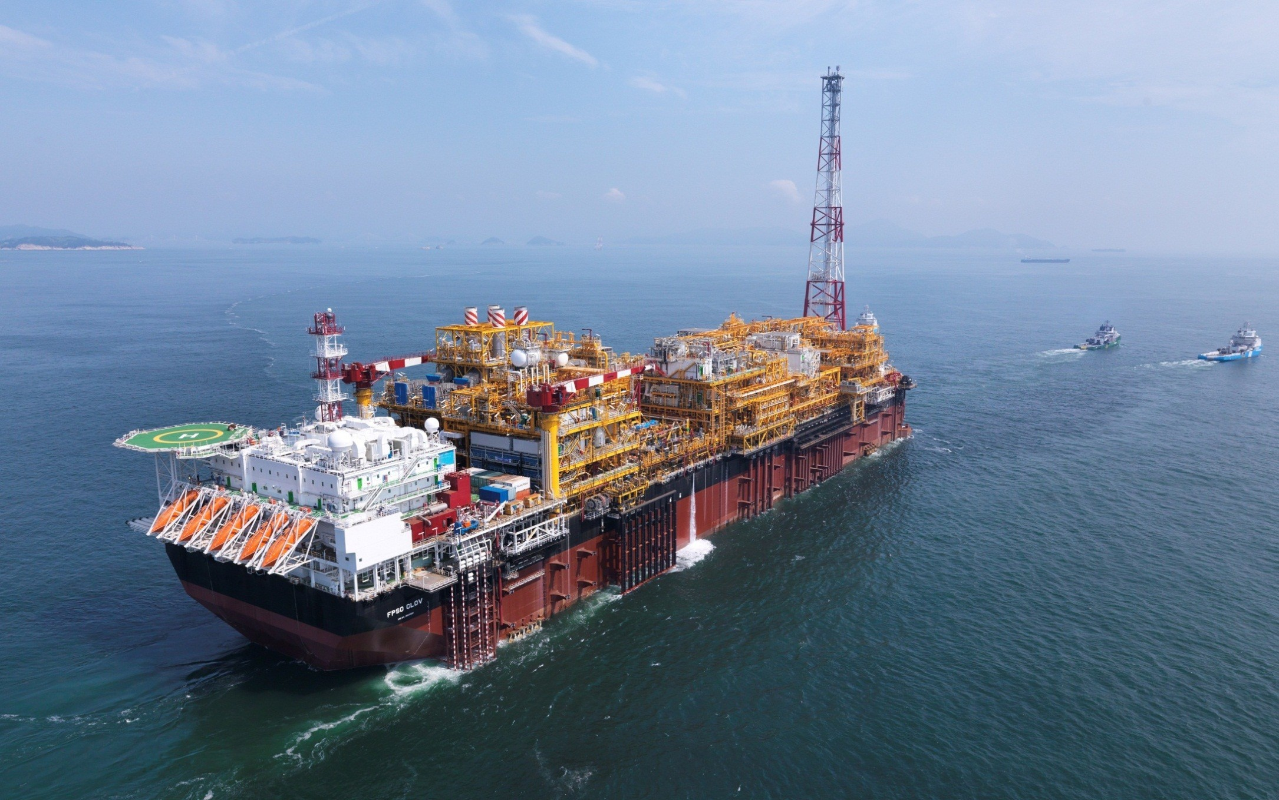
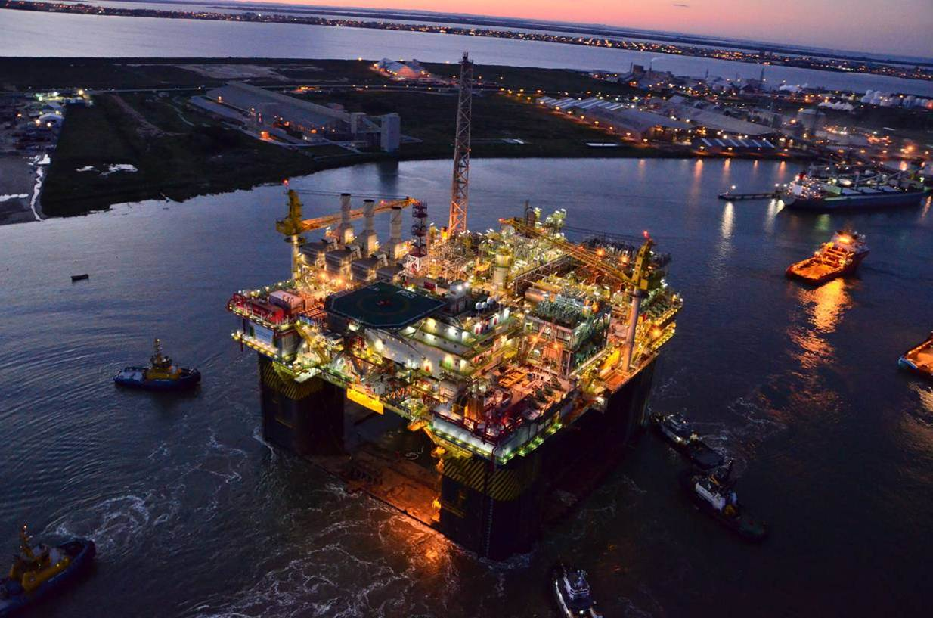
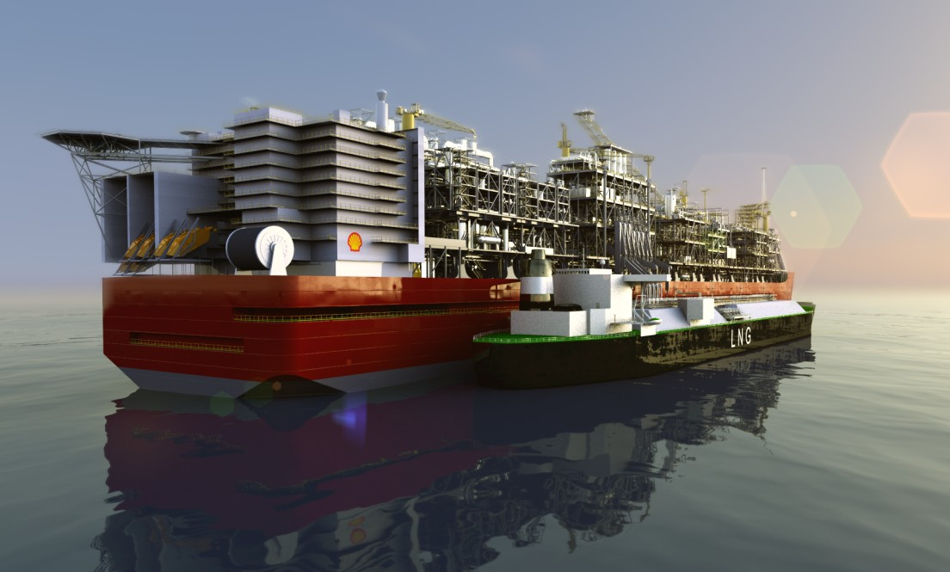
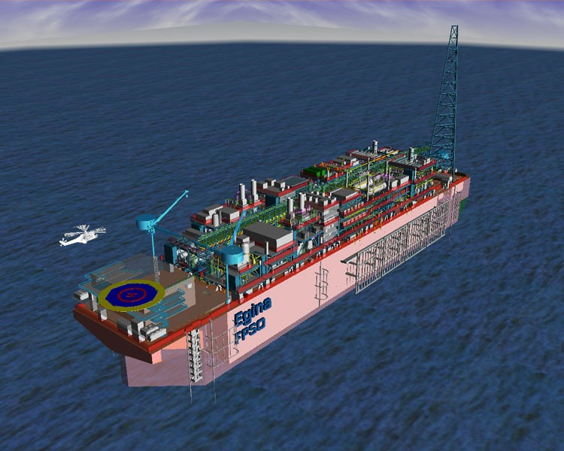
Selected Production Unit (New Building)
Total FPSO Clov
Petrobras P55
Shell Prelude FLNG
Total FPSO Egina
Notes:
le FPSO ( système flottant de production, de stockage et de déchargement) CLOV, est amarré au large de l’Angola et sert à stocker le pétrole extrait des fonds marin.
Le forage se fait entre 1100 m et 1400m de profondeur
La production sera de 160 000 barils par jour
Un circuit de 128 kms de tuyaux sous marins. Le FPSO est haut de 30 mètres et aussi large que la hauteur de la Tour Eiffel Il peut stocker un jour de consommation de pétrole d'un pays comme la France soit 2 millions de Barils, il faut environ 10 jours pour le remplir.
P55 : la plus grande plate-forme semi-submersible construit au Brésil (180.000 barrils/jour)
Prelude FLNG is the world's first floating liquefied natural gas platform as well as the largest ship ever constructed. The Prelude is being built by Samsung Heavy Industries in South Korea for Royal Dutch Shell.[1] It is 488 metres (1,601 ft) long, 74 metres (243 ft) wide, and made with more than 260,000 tonnes of steel.[2] In operation, it would weigh more than 600,000 tonnes; more than five times the weight of the largest aircraft carrier.
Total Upstream Petroleum Nigeria Limited (TUPNI) awarded the Egina Floating Production Storage Offloading (FPSO) vessel construction contract to Samsung Heavy Industries (SHI) in 2013. The Egina project is valued at USD 15 billion. It consists of 44 wells connected to the 2.3M barrel capacity FPSO with a 200 000 boepd processing capacity. First oil is expected in 2017

Slide 11
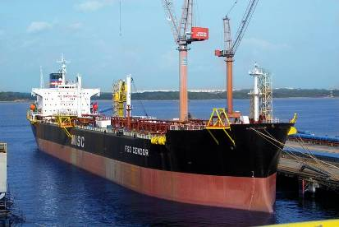
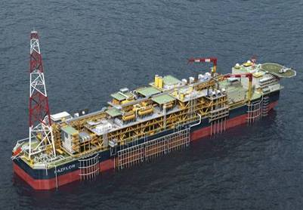
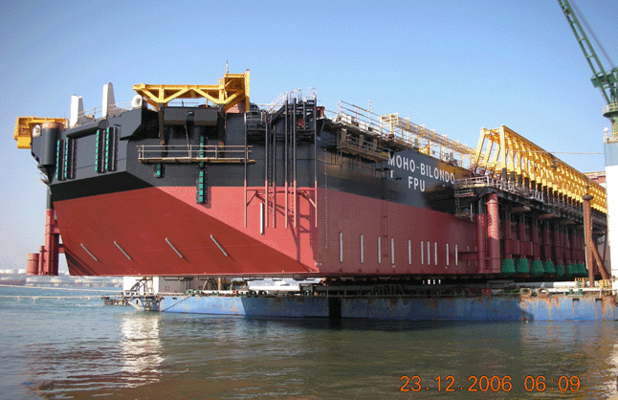
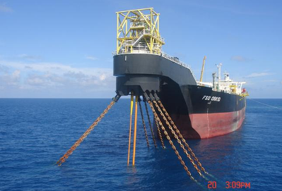
Selected F(P)SO (New Building)
CENDOR FSO in Malaysia for MISC
PAZFLOR FPSO for TOTAL
MOHO BILONDO FPU in
Congo for TOTAL
ORKID FSO for MISC

Slide 12
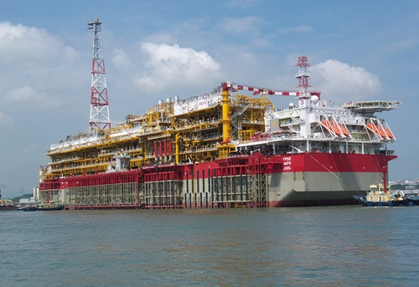


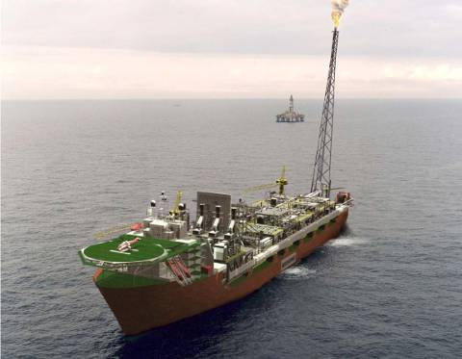
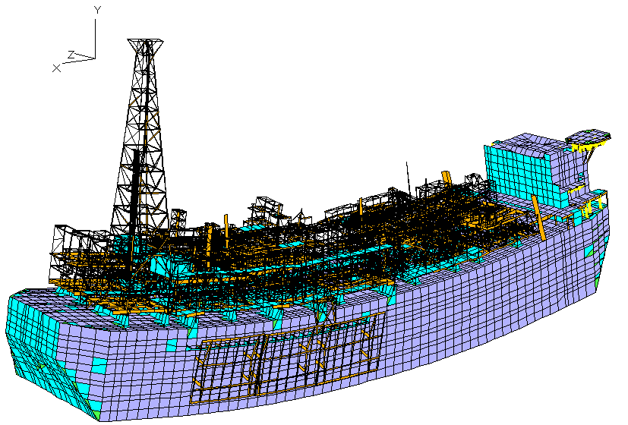
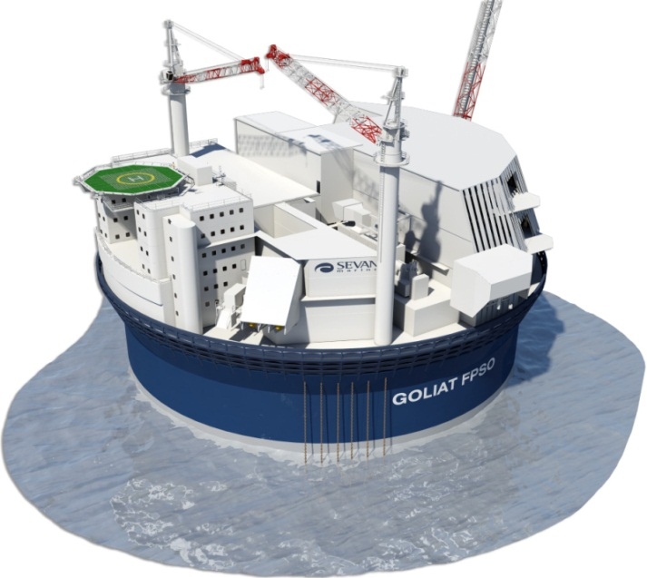

FSO & FPSO: Class & Technical Assistance studies
More than 130 FSOs & FPSOs classed or studied by BV:
50% of the existing fleet.
SKARV FPSO
for BP / STATOIL in Norway
BV: a world leader in Fatigue Analysis, Hydrodynamics & Mooring of Floating Units
IVB Services for ENI Norge (Norway)

Slide 13
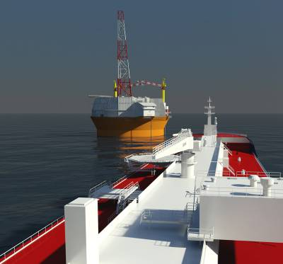
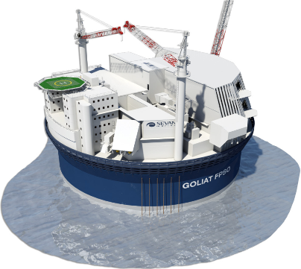

GOLIAT FPSO
IVB (Indenpendent Verification Body) Services for ENI Norge (Norway)
Diameter = 100 m Depth= 50 m
Draft= 30m Displacement= 214 000t

Slide 14

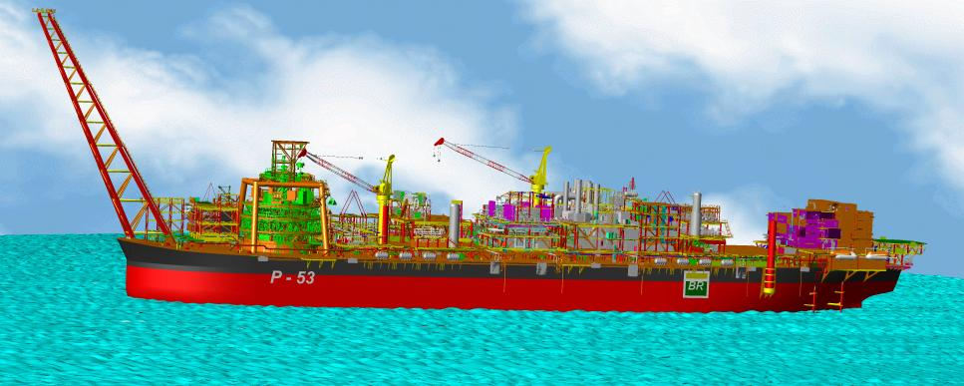




FPU P-53 : Classification & Certification of Operability
Project Overview
Operation : 25 years
Water Depth : 1080m water depth
Oil production capacity : 180,000 barrels
Topsides (Brazil & Singapore) & Integration (Brazil)
Main Contractors
FLARE BOOM
Turret Design
Generation Module
Hull Conversion
and
Turret Construction
Gas Compression Module

Slide 15
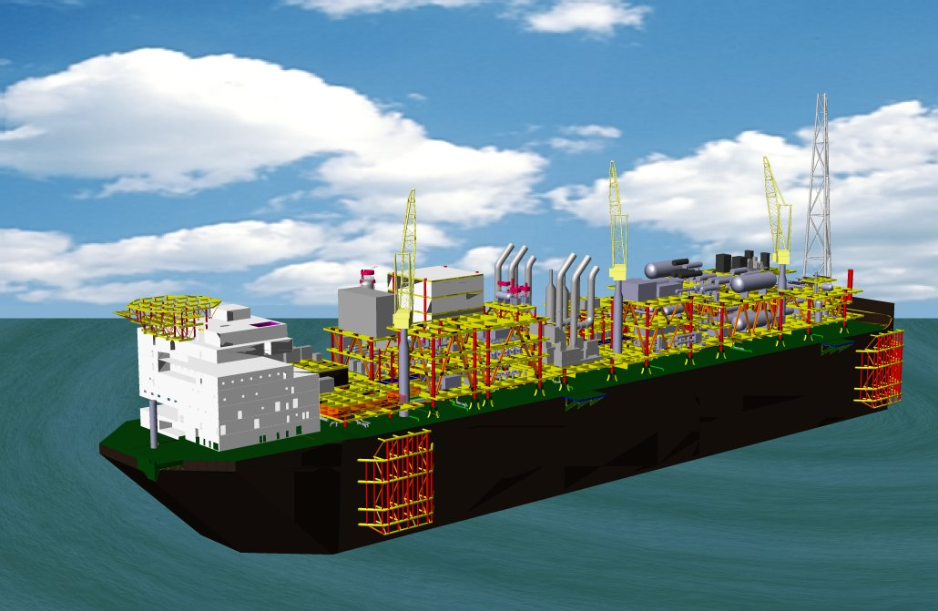
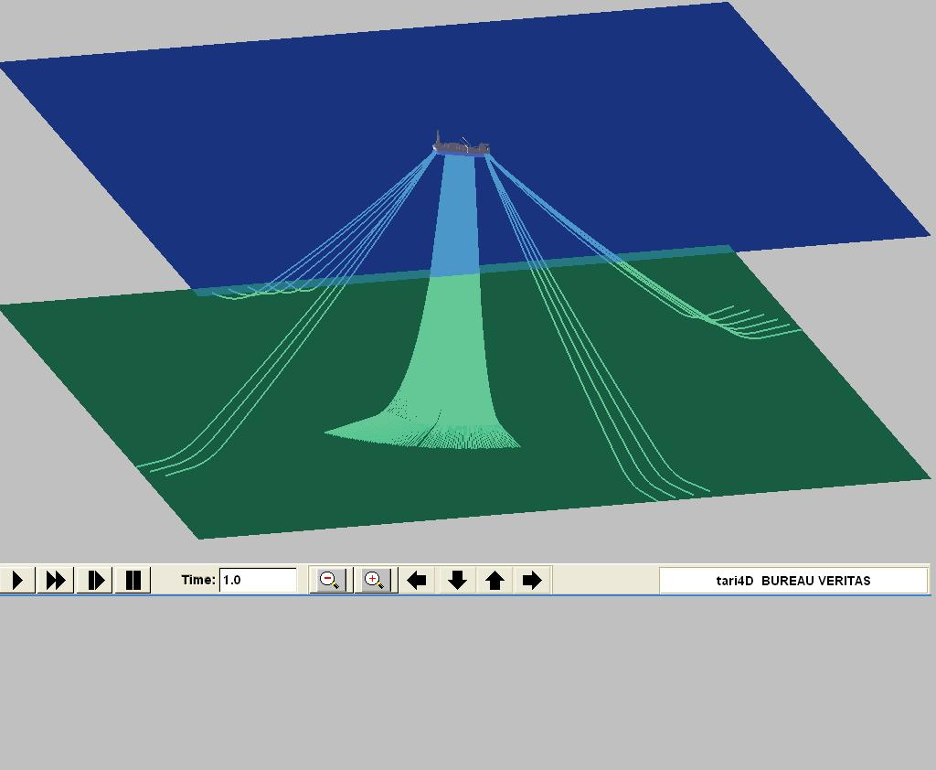
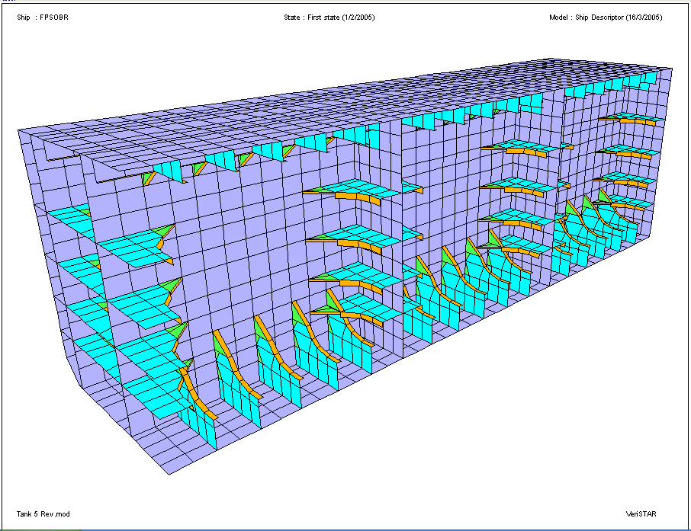
FPSO-BR P-57 – FEED Certification
Project Overview
  New double-side design developed by Petrobras/CENPES
  Oil Production Capacity :180,000 bopd
  Storage Capacity :1,850,000 barrels
  Water Depth : 1246 m
BV Scope of Work
  Certification of Basic Design according to BV Rules and International Regulations (Statutory)
  Total timeframe of main work : 5 months
  Approx. 1000 reviewed documents
  Independent calculations to check the design for:
    Stability – Intact and Damage
    Hydrodynamic – Motions, accelerations and wave induced loads
    Structure – Global / Local Models and Fatigue
    Mooring
  Process Plant certification – BV Notation PROC

Slide 16
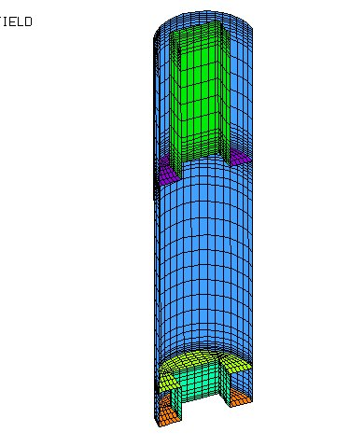
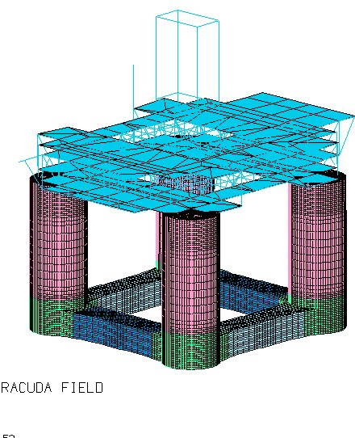
TLWP / SPAR : Independent Verification/Certification
Basic Design calculations for dry completion floating units options intended for Campos Basin deep water fields
  Tension Leg Wellhead Platform (TLWP)
  Spar-buoy type Wellhead Platform
    Topsides and Facilities systems verification
    Independent motions and structural calculation

Slide 17
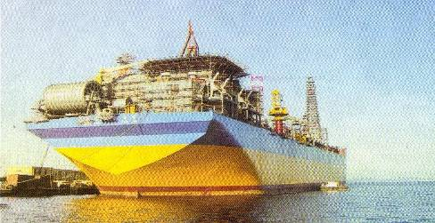
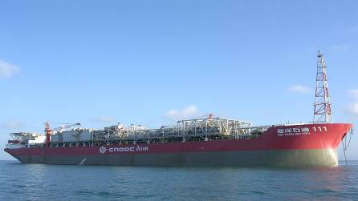
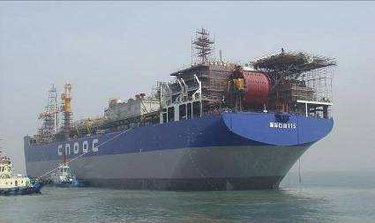
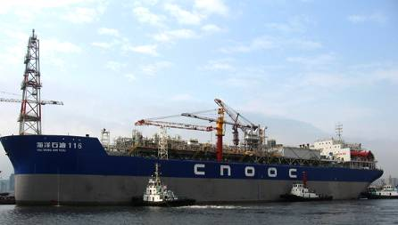
Offshore Experience
Start from 2000, BV Classed all the new building FPSOs in South China Sea, with turret mooring system
NAN HAI FEN JIN FPSO for CNOOC
Built in DSIC for WenChang oil field
HAI YANG SHI YOU 111 FPSO for CNOOC
Built in SWS for Panyu oil filed
HAI YANG SHI YOU 115 FPSO for CNOOC
Built in Qingdao Beihai Shipyard
for Xijiang oil field
HAI YANG SHI YOU 116 FPSO for CNOOC
Built in DSIC for Wenchang oil field

Slide 18
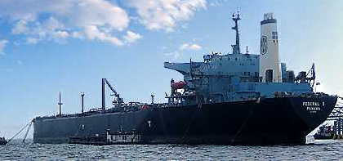
Offshore Experience
FEDERAL I FSO for PetroChina
in Jabung Block, Indonesia.

Slide 19
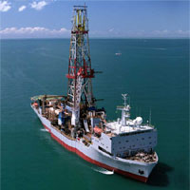
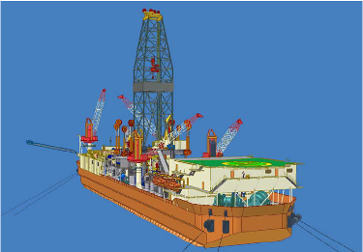
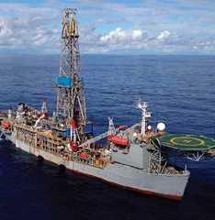
OFFSHORE References: Drilling Ship
BUREAU VERITAS is involved in the classification of Drilling ship since 1942
  S C LANCER
  NOBLE MURAVLENKO
  NOBLE ROGER EASON
  EQUATORIAL DRILLER
  Drilling Ship CERRADO
  Drilling Ship SERTÃO ... ...
  … …

Slide 20
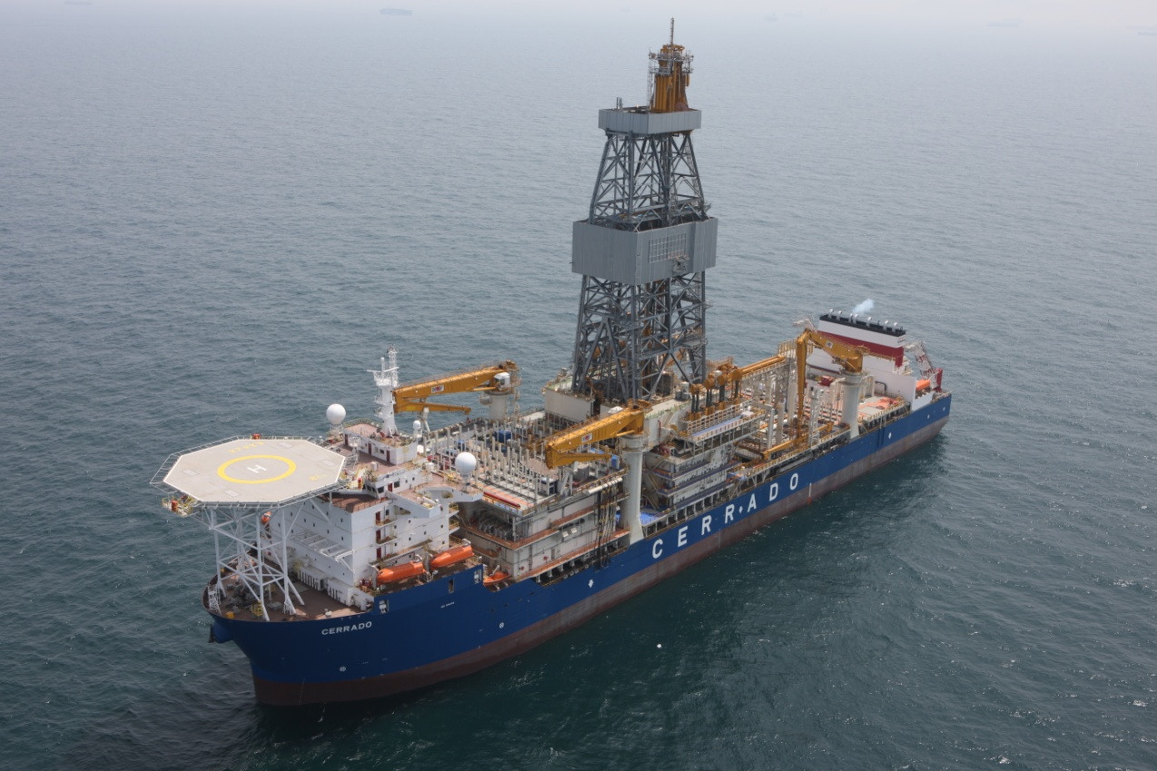
Typical Offshore Reference: New Drilling Ship Project
Technical Details
Owner: Schahin Petroleo
Builder: Samsung Heavy Industries Co Ltd
Length Overall: 228 m
Breadth: 42 m
Height to main Deck: 19 m
Operating Draft: 12 m
Ocean Transit Draft: 8,5 m
Accommodation: 200 berths
Max Drill Depth: 11,400 m
Max Water Depth: 3,000 m

Slide 21

GUSTO PRD12,000 – Ship characteristics
Typical Offshore Reference: New Drilling Ship Project
Length over all: 210.00 m
Length between perpendiculars: 198.01 m
Scantling length 194.49 m
Breadth moulded: 32.00 m
Depth moulded at centerline: 17.50 m
Scantling draught: 11.00 m
Displacement at scantling draught: ≈58,695 t
Moonpool length: 25.20 m
Moonpool breadth: 12.60 m
Cb : 0.825
Transit speed : 11 knots

Slide 22


SELECTED OFFSHORE LNG TERMINALS
BV involved in 15 on-going OFFSHORE LNG projects as follows:
Australia: Prelude for SHELL
Generic LNG FPSO for GDFSUEZ
Africa: FLSO project for SHELL
Europe: OLT (Livorno) for SAIPEM and E-ON
Triton for GDF
FLNG for SAIPEM
South America: Brazil: Tupi for PETROBRAS
Small scale terminals for various with contractors for utility companies
China: Projects of offshore LNG terminals in cooperation with MARIC & CNOOC (Small and large scale LNG FPSO, large scale FSRU)
China: FSRU project
South-East Asia 1 LNG FPSO project with Saipem

Slide 23


Bureau Veritas Selected References LNG FSRU
Bureau Veritas classes the first ever series of LNG RV built:
  3 vessels of 138,000m3 for Exmar and Excelerate Energy at DSME in 2005 and 2006
  5 vessels of 151,000m3 for Exmar and Excelerate Energy at DSME from 2008 to 2010
  1 vessel of 170,000m3 for Dynagas at STX (delivery 2016)
  1 FSRU of 173,500m3 for Excelerate Energy at DSME (delivery 2014)
  1 FSRU of 260,000m3 at DSME (the biggest FSRU in the world)
  1 FSRU of 25000m3 at WISON (SPB tank)

Slide 24










SEMI-SUB: Class & Technical Assistance studies
BV Classes and Certifies more than 20 Semi Submersible Units
P55 SEMI for PETROBRAS
(Brazil)

Slide 25




SEMI-SUB: Class & Technical Assistance studies
Pride South Atlantic：Recently 5 Semi-Sub Classed by BV,
One Semi-sub moved to China and used by COSL
Mesh VII – Bracing Connection on CL

Slide 26


SEMI-SUB: Class & Technical Assistance studies
Recently, 2 Drilling Semi-Subs from Schahin are classed by BV (CAC to BV) in Brazil working for Petrobras.
Drilling SEMI SS PANTANAL
Drilling SEMI SS AMAZONIA

Slide 27








BV OFFSHORE References: Jack Up Units
Classification
  More than 40 Self-Elevating Units Classed with Bureau Veritas

Slide 28


Recent Jackup experiences
  Classification of docking barge jack-up (2009)
  Classification of SEAWORK 1 Drilling Jack-up(2009) and site conditions modifications (2010) for PERENCO
  SEP ORION for Eunsung Construction - Special service (shore construction work) Jack-up- Operating water depth 130 ft (2010)
  Classification of Jack up AFCONS - WD 30m (March 2011)
  350 ft Drilling Jack-ups in Singapore
  375 ft Drilling Jack-ups in Singapore
  400 ft Drilling Jack-ups in SEA
  5 Production Jackup Units (MOPU) in SEA
  JUB-350 Jackup for Estonia company
  ROC Oil Production Jackup

Slide 29


Recent Jackup experiences
  Big Pitcher - Basic design review - Self Propelled (wind milIs Installation Vessel)
  CJ46 50- GUSTO/MSC design approval - Operating water depth 300 to 400 ft
  JU2000 - Design approval
  LG 250 Mod A - LION GLOBAL design Approval - Operating water depth 100 to 250 ft
  LG 450 Mod A LION GLOBAL design - Concept Approval - Operating water depth 300 to 450 ft
  CEZEMBRE Jackup CMR design
  300ft Jackup design of COSCO shipyard

Slide 30



